Slide 1
SALES DATASET ANALYSIS
VEENA SRI PM
DATA ANALYTICS & DATA SCIENCE
RP33

Slide 2
OBJECTIVE
To examine and assemble applicable data’s from the dataset, understanding sales performance and strategies to deliver informative observations and uncover opportunities with data driven decisions to improve sales.
GOALS
Analyse sales dataset.
Extract data accuracy.
Determine highest sales.
Create collective dashboard.
Identify solutions to increase sales.

Slide 3
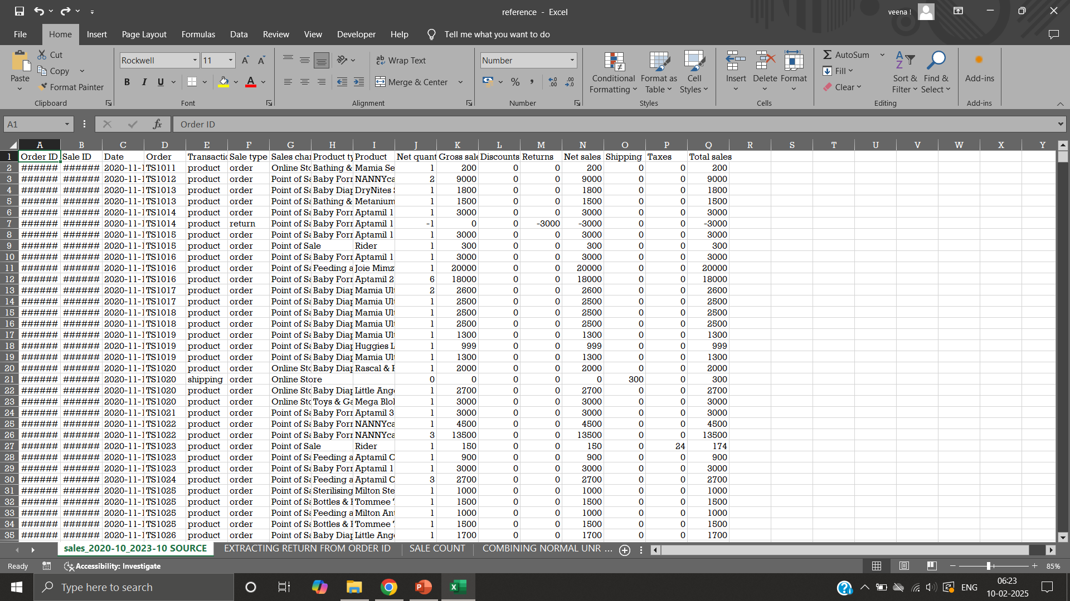
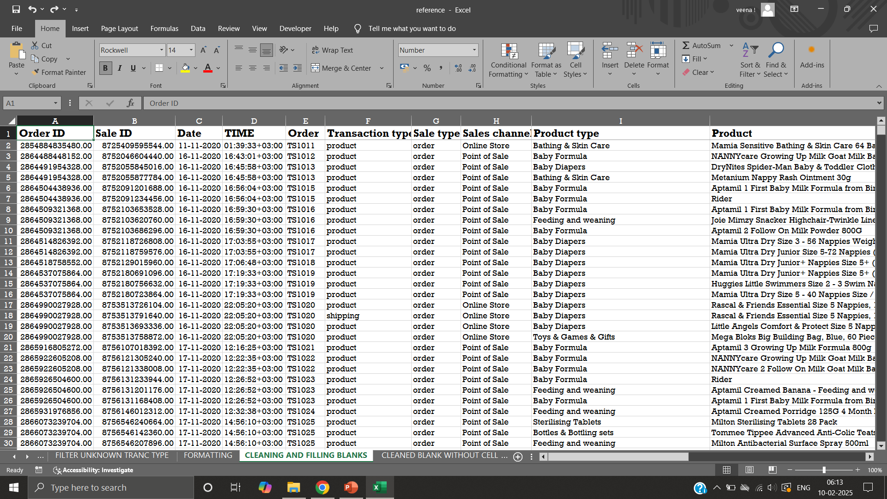
DATASET OVERVIEW
DATA CLEANING
Ranges between the year 2020-2023.
Details-Order ID, Sale ID, Net quantity, Product, Product type, Gross sales, Returns, Discounts, Net sales are present.
Strategies - clearly categorized.
Deals - baby relevant products and product type.
Data- Formatting, Freeze row, Blanks, Remove duplicates.
Data validation for date column.
RAW DATA
FORMATTED DATA

Slide 4
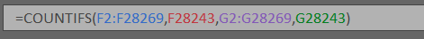
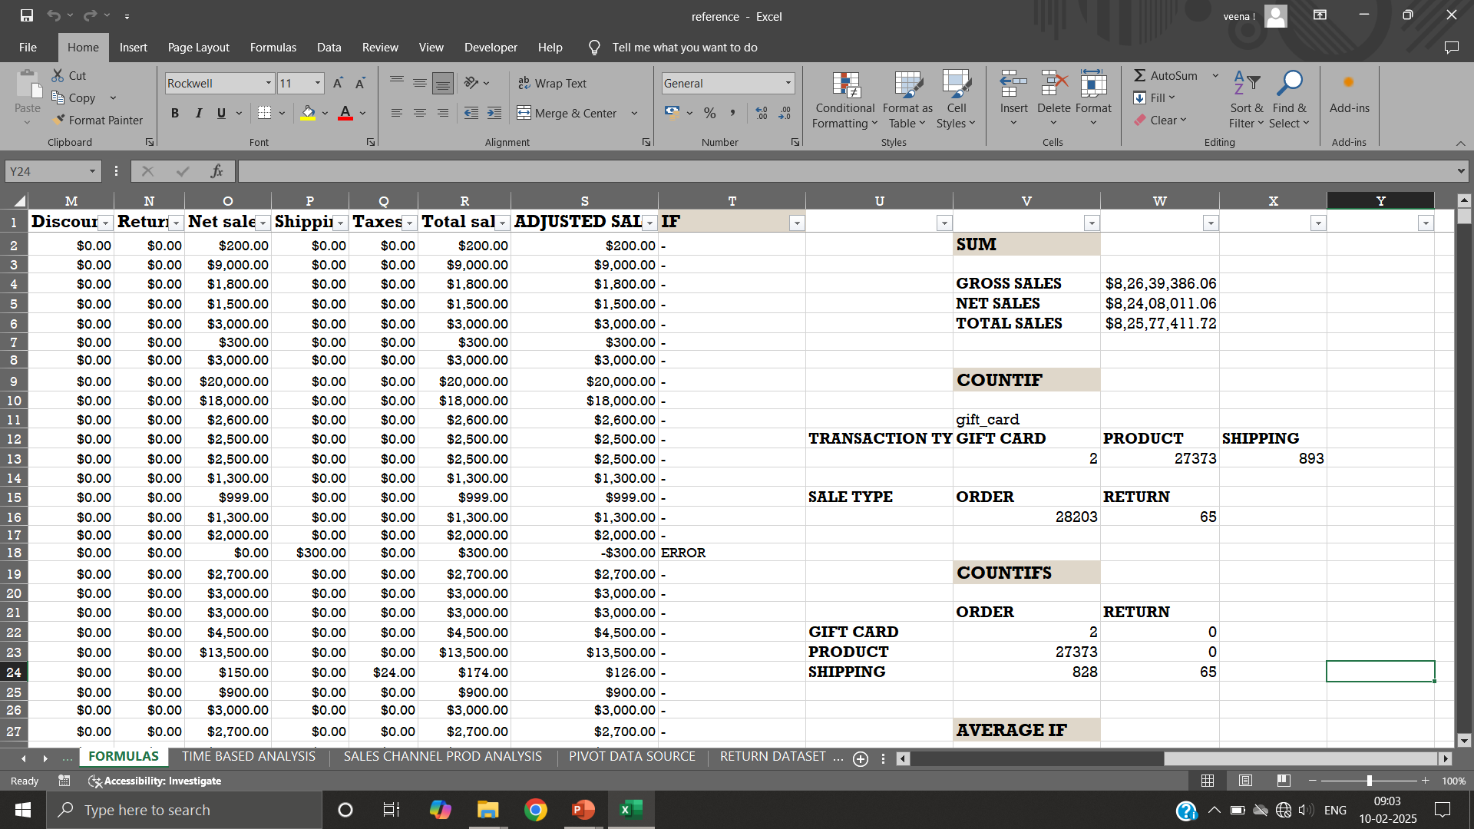
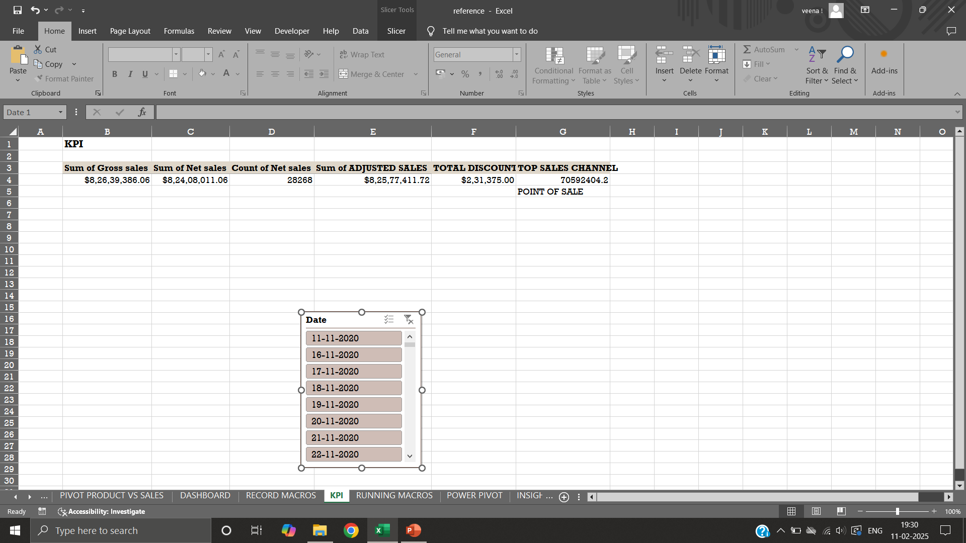
KEY METRICS
FORMULAS
Sum Of Gross Sales
Sum Of Net Sales
Sum Of Adjusted Sales
Count Of Net Sales
Adjusted Sale
Average If
Count Ifs
Count If

Slide 5
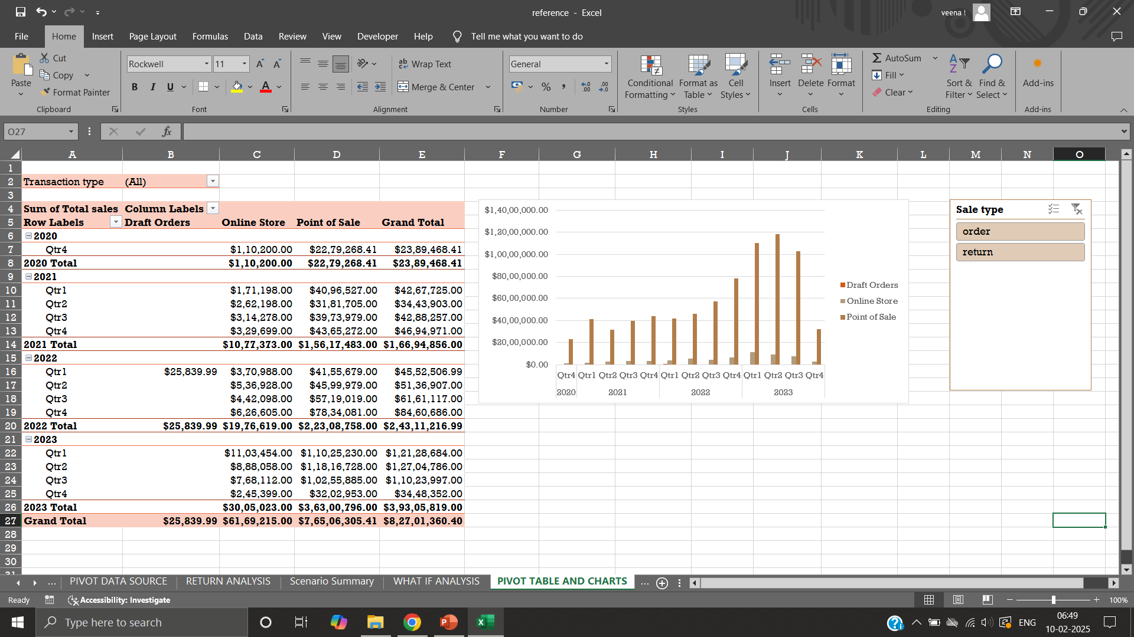
PIVOT TABLE
VISUALS
Easy to summarize, analyse and organise large dataset.
Identify patterns and trends.
Compares sales among categories.
Major role in creating dashboards.
Visual representation of pivot table is pivot chart.

Slide 6
dashboard
Displays key information in visual format, helping in decision making at a glance.
Monitoring, Measuring and analysing data.
Visual filtering tools - KPIs and Slicers.
Combination of charts, slicers and KPIs.

Slide 7
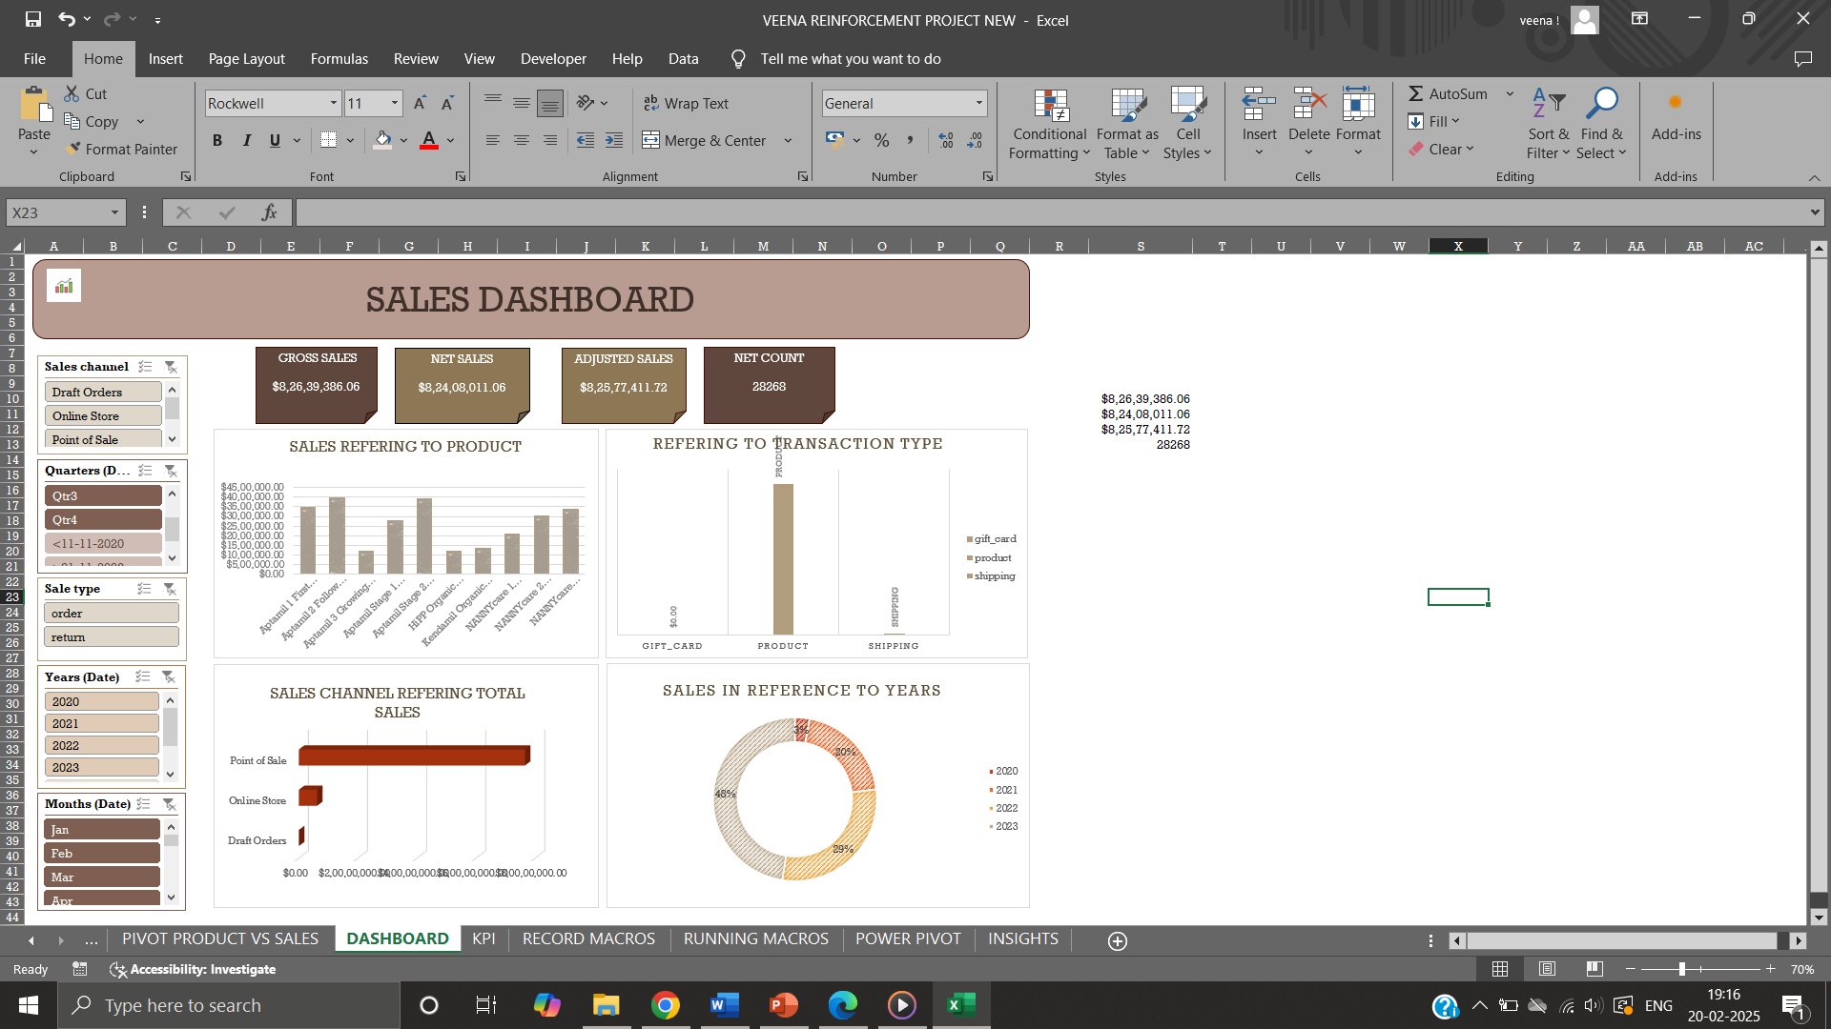

Slide 8
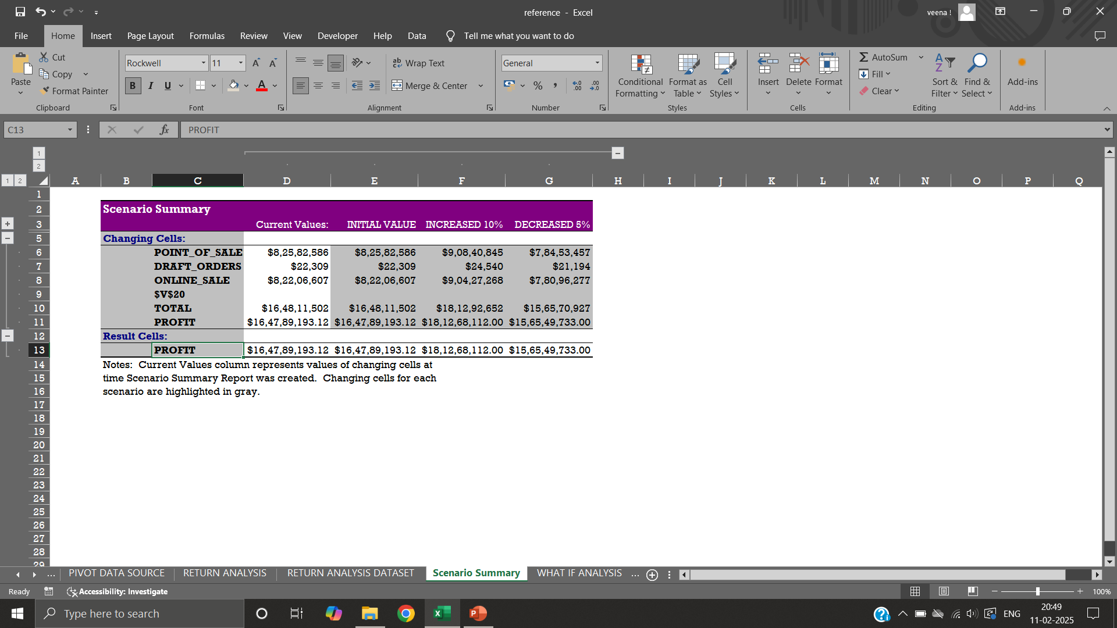
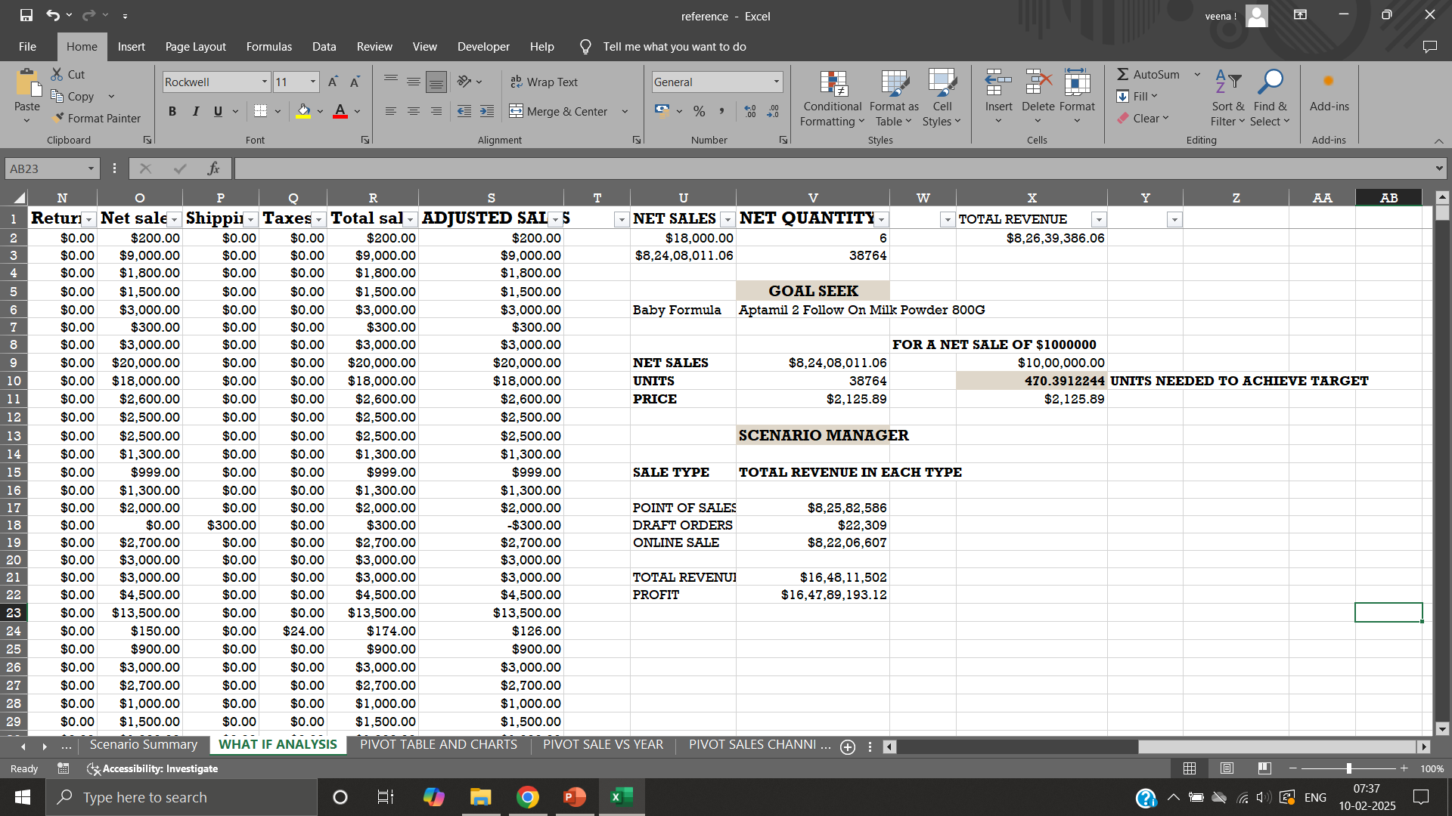
WHAT IF-ANALYSIS
GOAL SEEK
Aids in outlook of how changing cell values affects the outcome of a formula.
Sensitivity analysis.
Scenario manager, Goal seek, Data tables.
Tool that helps in finding the input value needed to produces a desired result in a formula.
Trial and error method.
Back solve a problem.

Slide 9
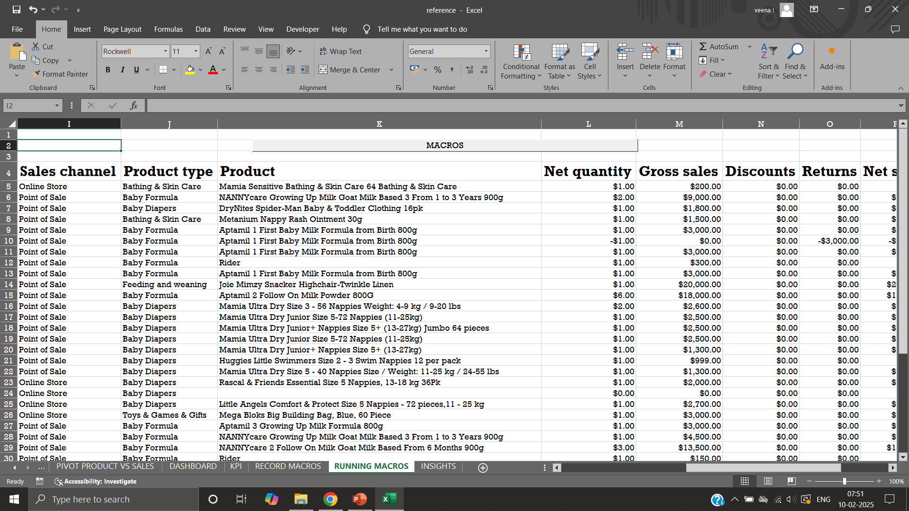
MACROS
Automation benefits
Set of actions that can be recorded and run automatically across sheets to perform repeating tasks.
Actions like Cleaning, Formatting, Freezing panes - automated with macros.
Assigning and accessing macros to buttons helps effortless functioning across sheets.
Saves time.
Reduce errors.

Slide 10
INSIGHTS
FUTURE RECOMMENDATION
Highest revenue - Point of Sale channel type.
Aptamil Stage2 follow on milk powder 800gm-$39,19,900.00 - count of 740 units.
Baby activity Toys & games & gifts - color wonder paw patrol -low sales of $950.00 - only 2 units sold.
Aptamil organic baby rice 100gm 4th+ generated negative revenue in online sale by -$300.
Sales increased in the year 2023, second quarter respectively.
Proposing directions to enhance its sales with price elasticity.
Promotional activity.
Introducing new product launches.
Potential areas like Regional analysis should be considered.

Slide 11

CONCLUSION
Sales dataset is analyzed and an interactive dashboard is created for better understanding of performance, impacts of strategies and implementing future recommendations will improve overall sales.

